Slide 1

Notes:
<script type="module"> import mermaid from 'https://cdn.jsdelivr.net/npm/mermaid@11/dist/mermaid.esm.min.mjs'; </script>

Slide 2
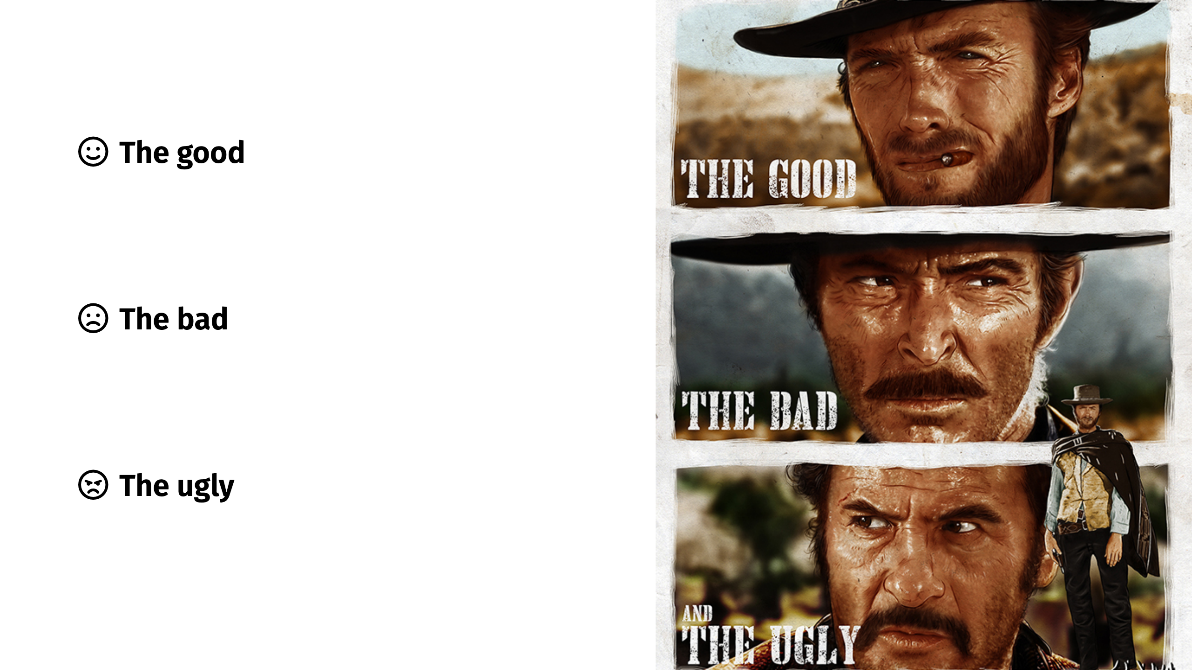

Slide 3
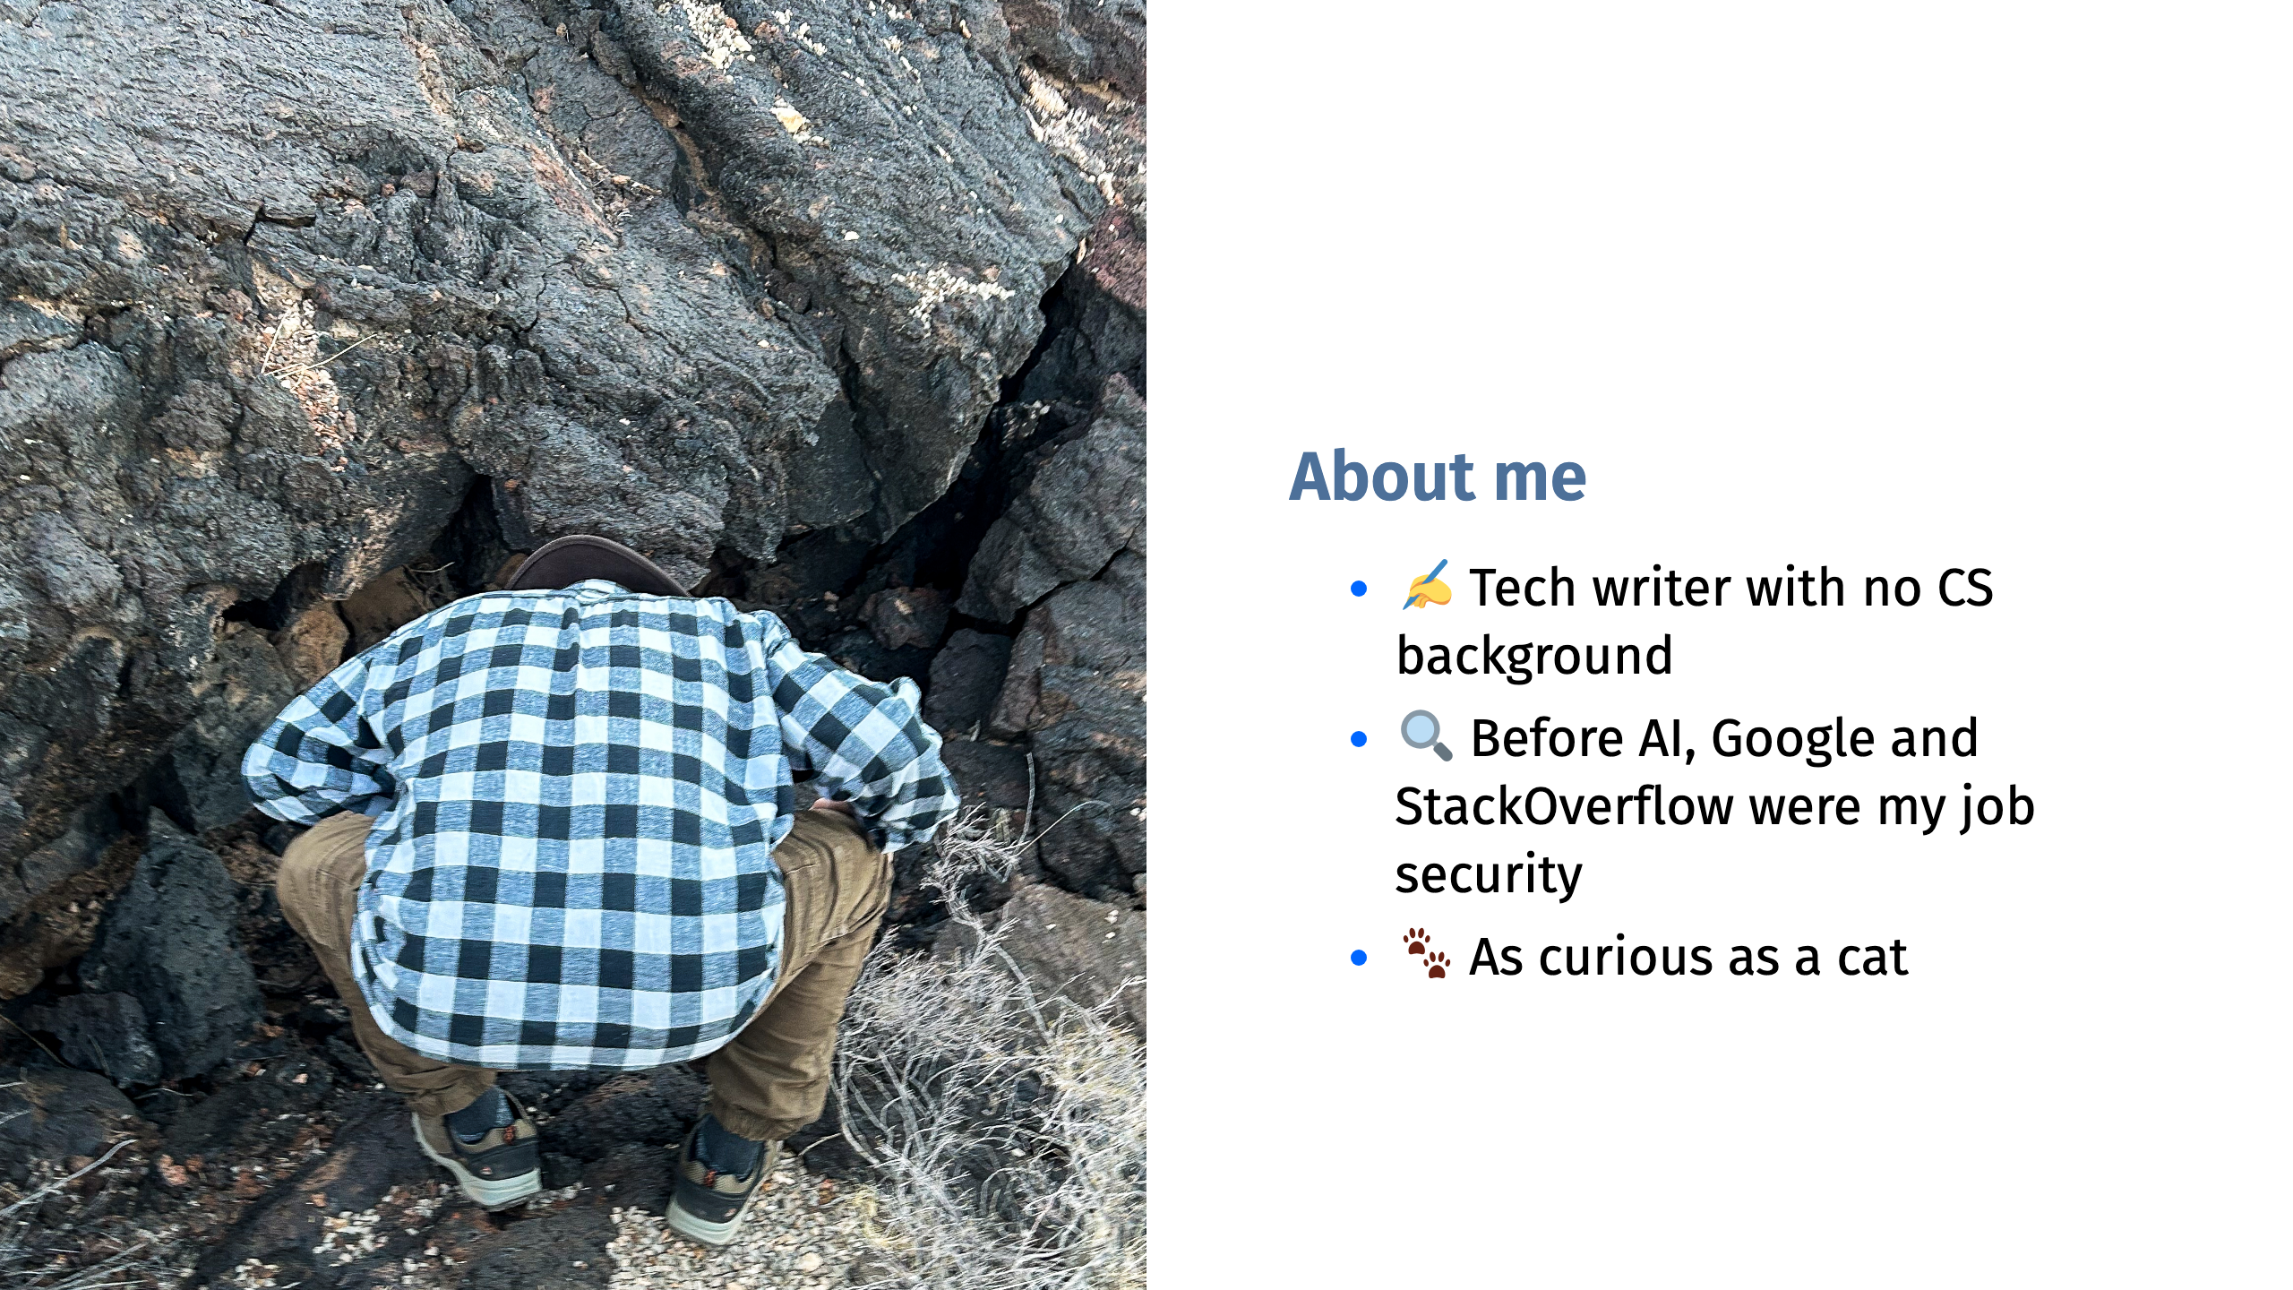

Slide 4
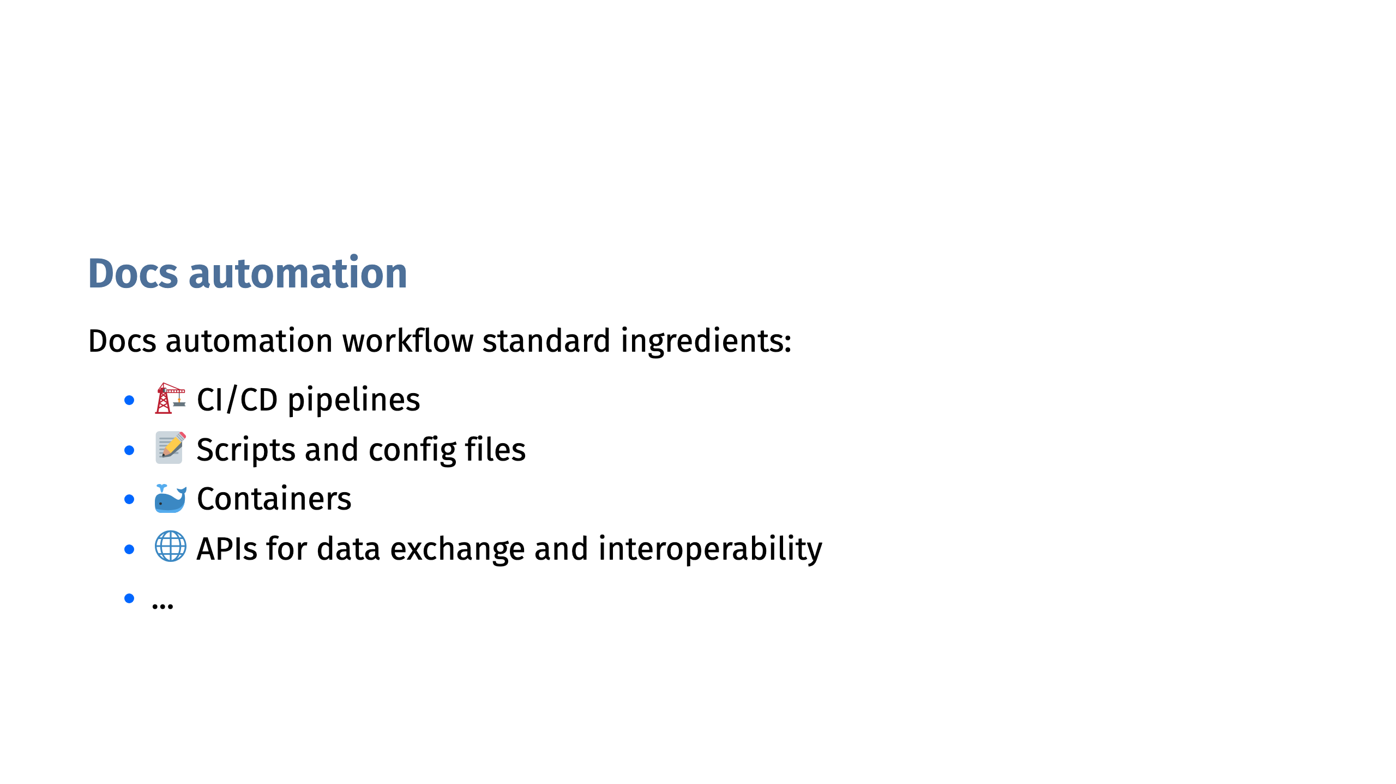

Slide 5
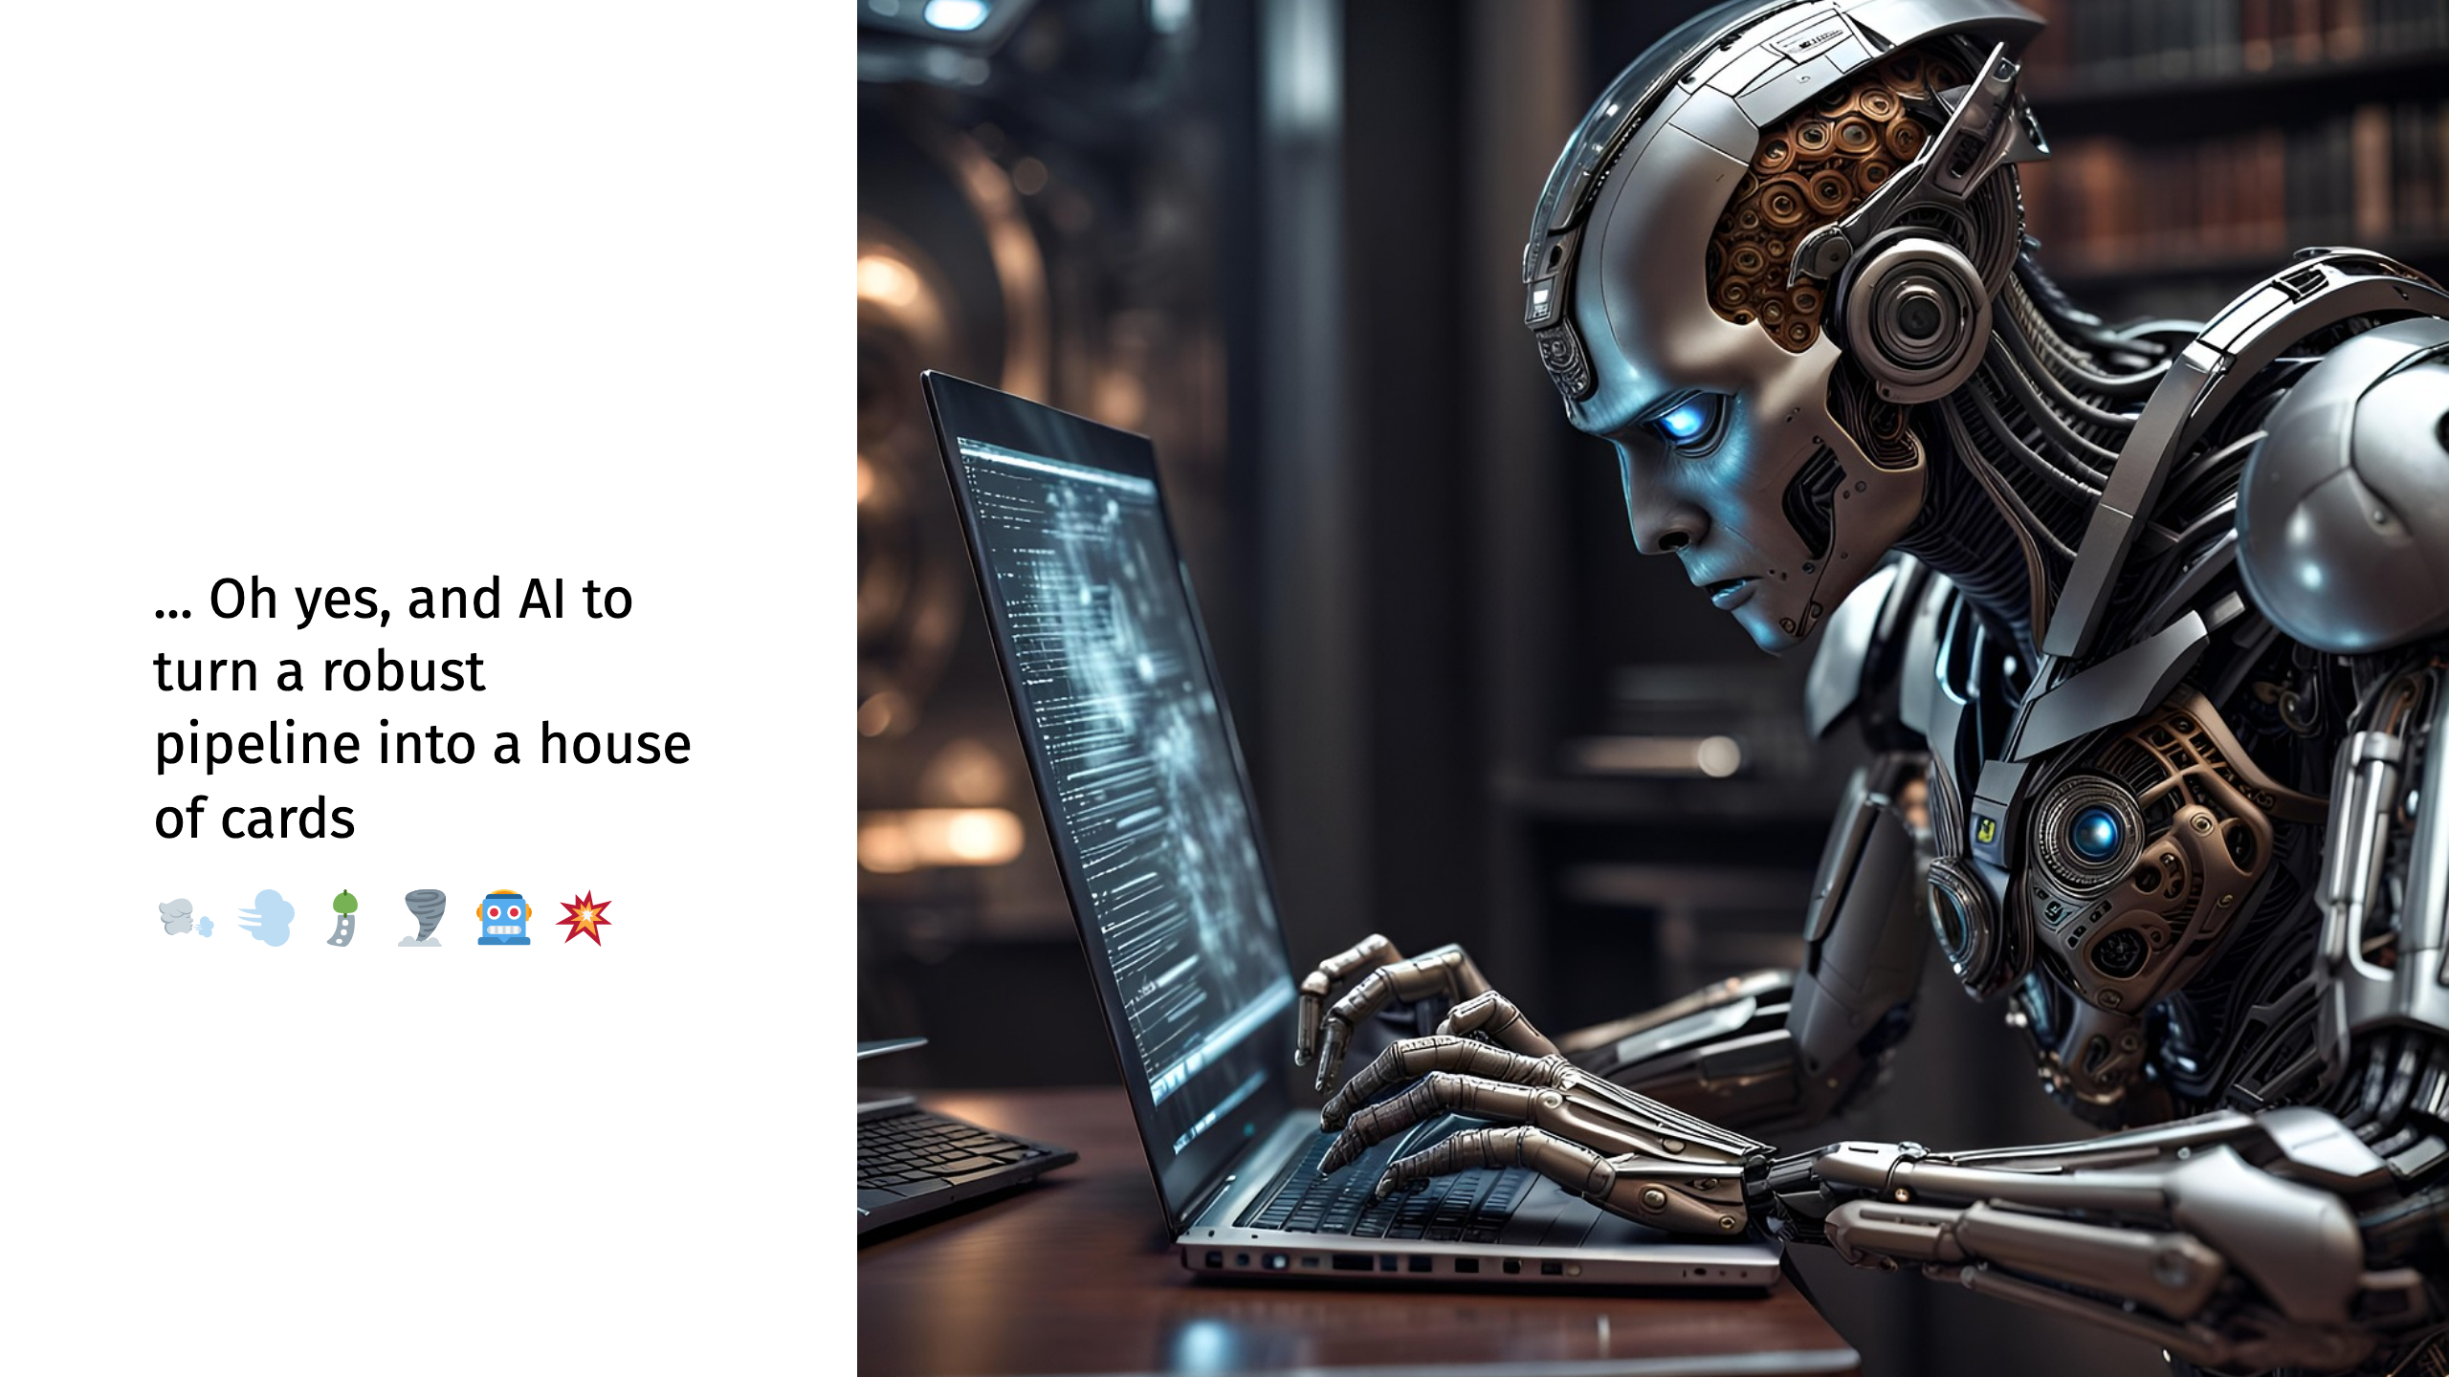

Slide 6
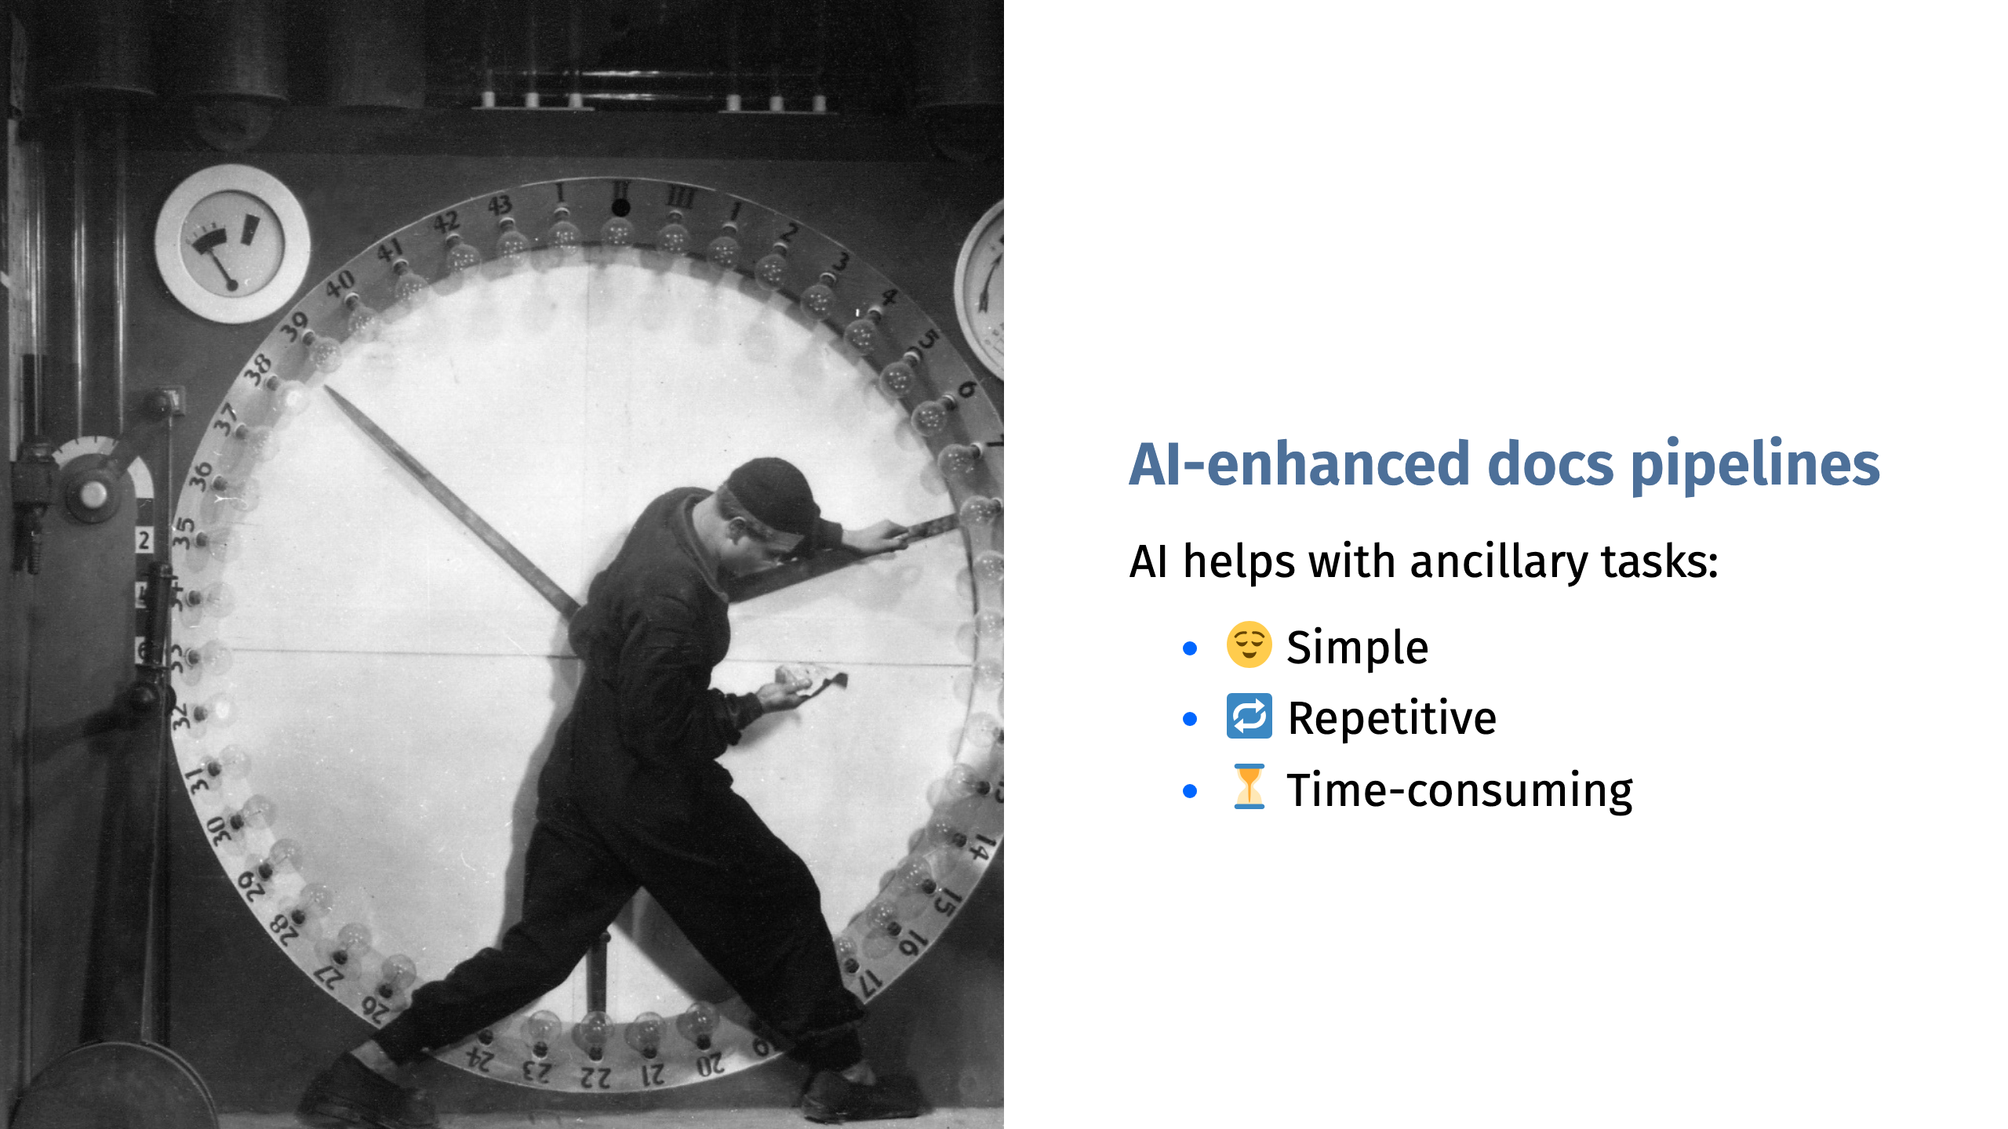
Notes:
AI is good at probabilistic quality: good enough. Bad at deterministic quality: exact, repeatable, always 100% consistent

Slide 7
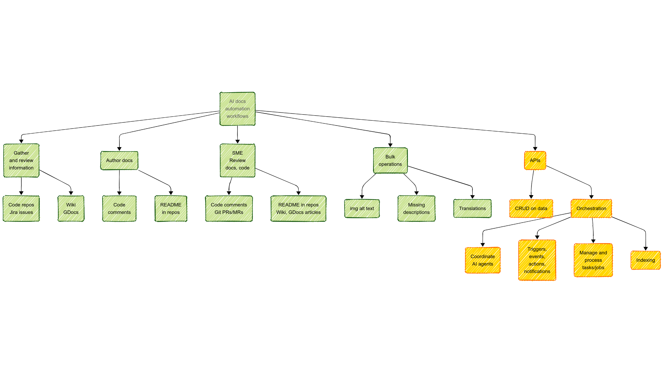

Slide 8
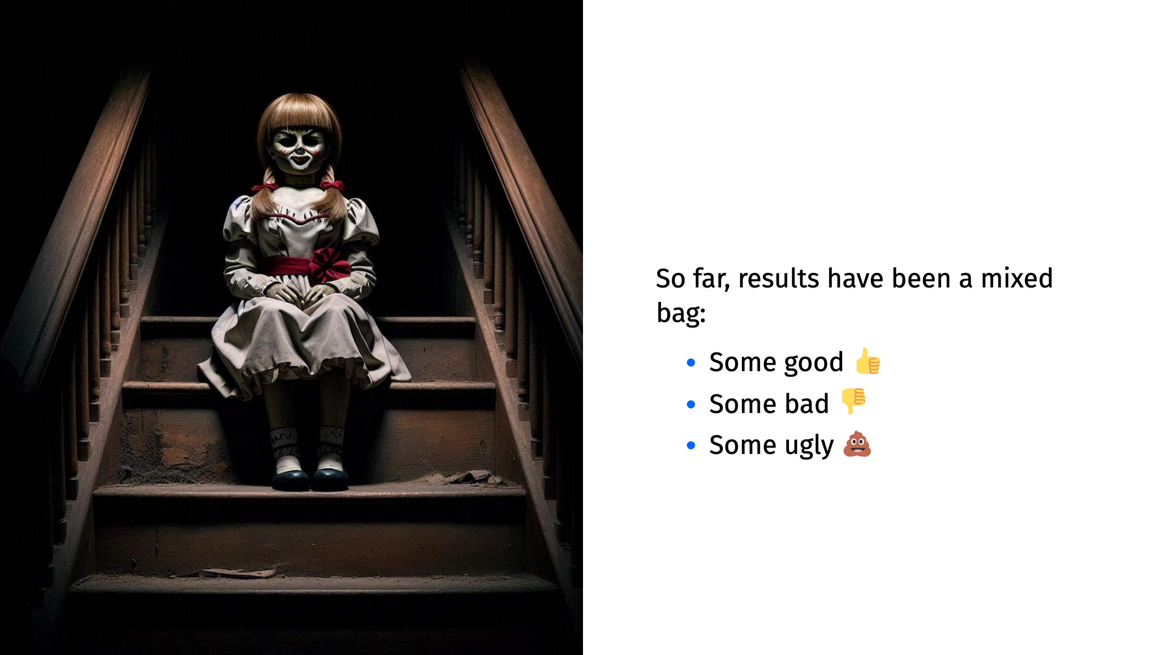

Slide 9
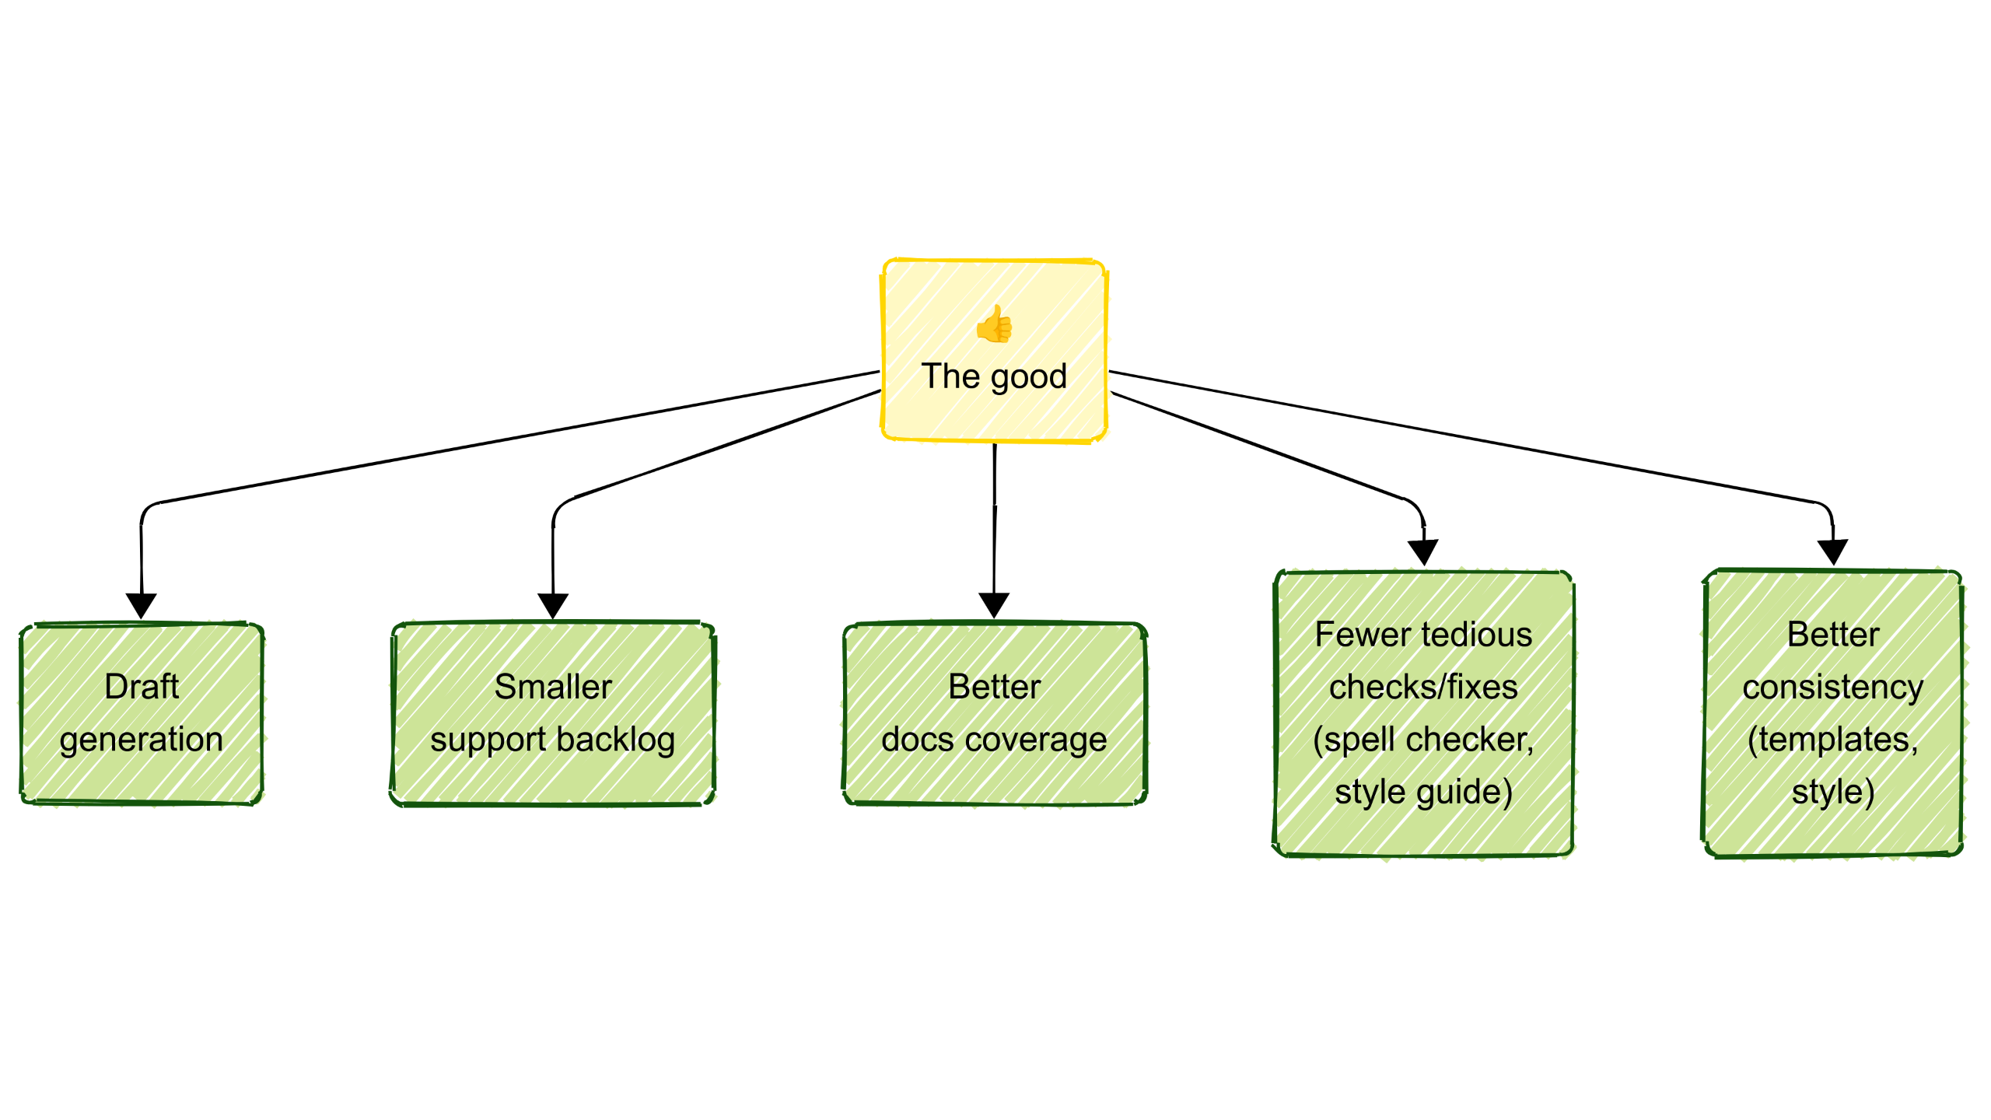

Slide 10
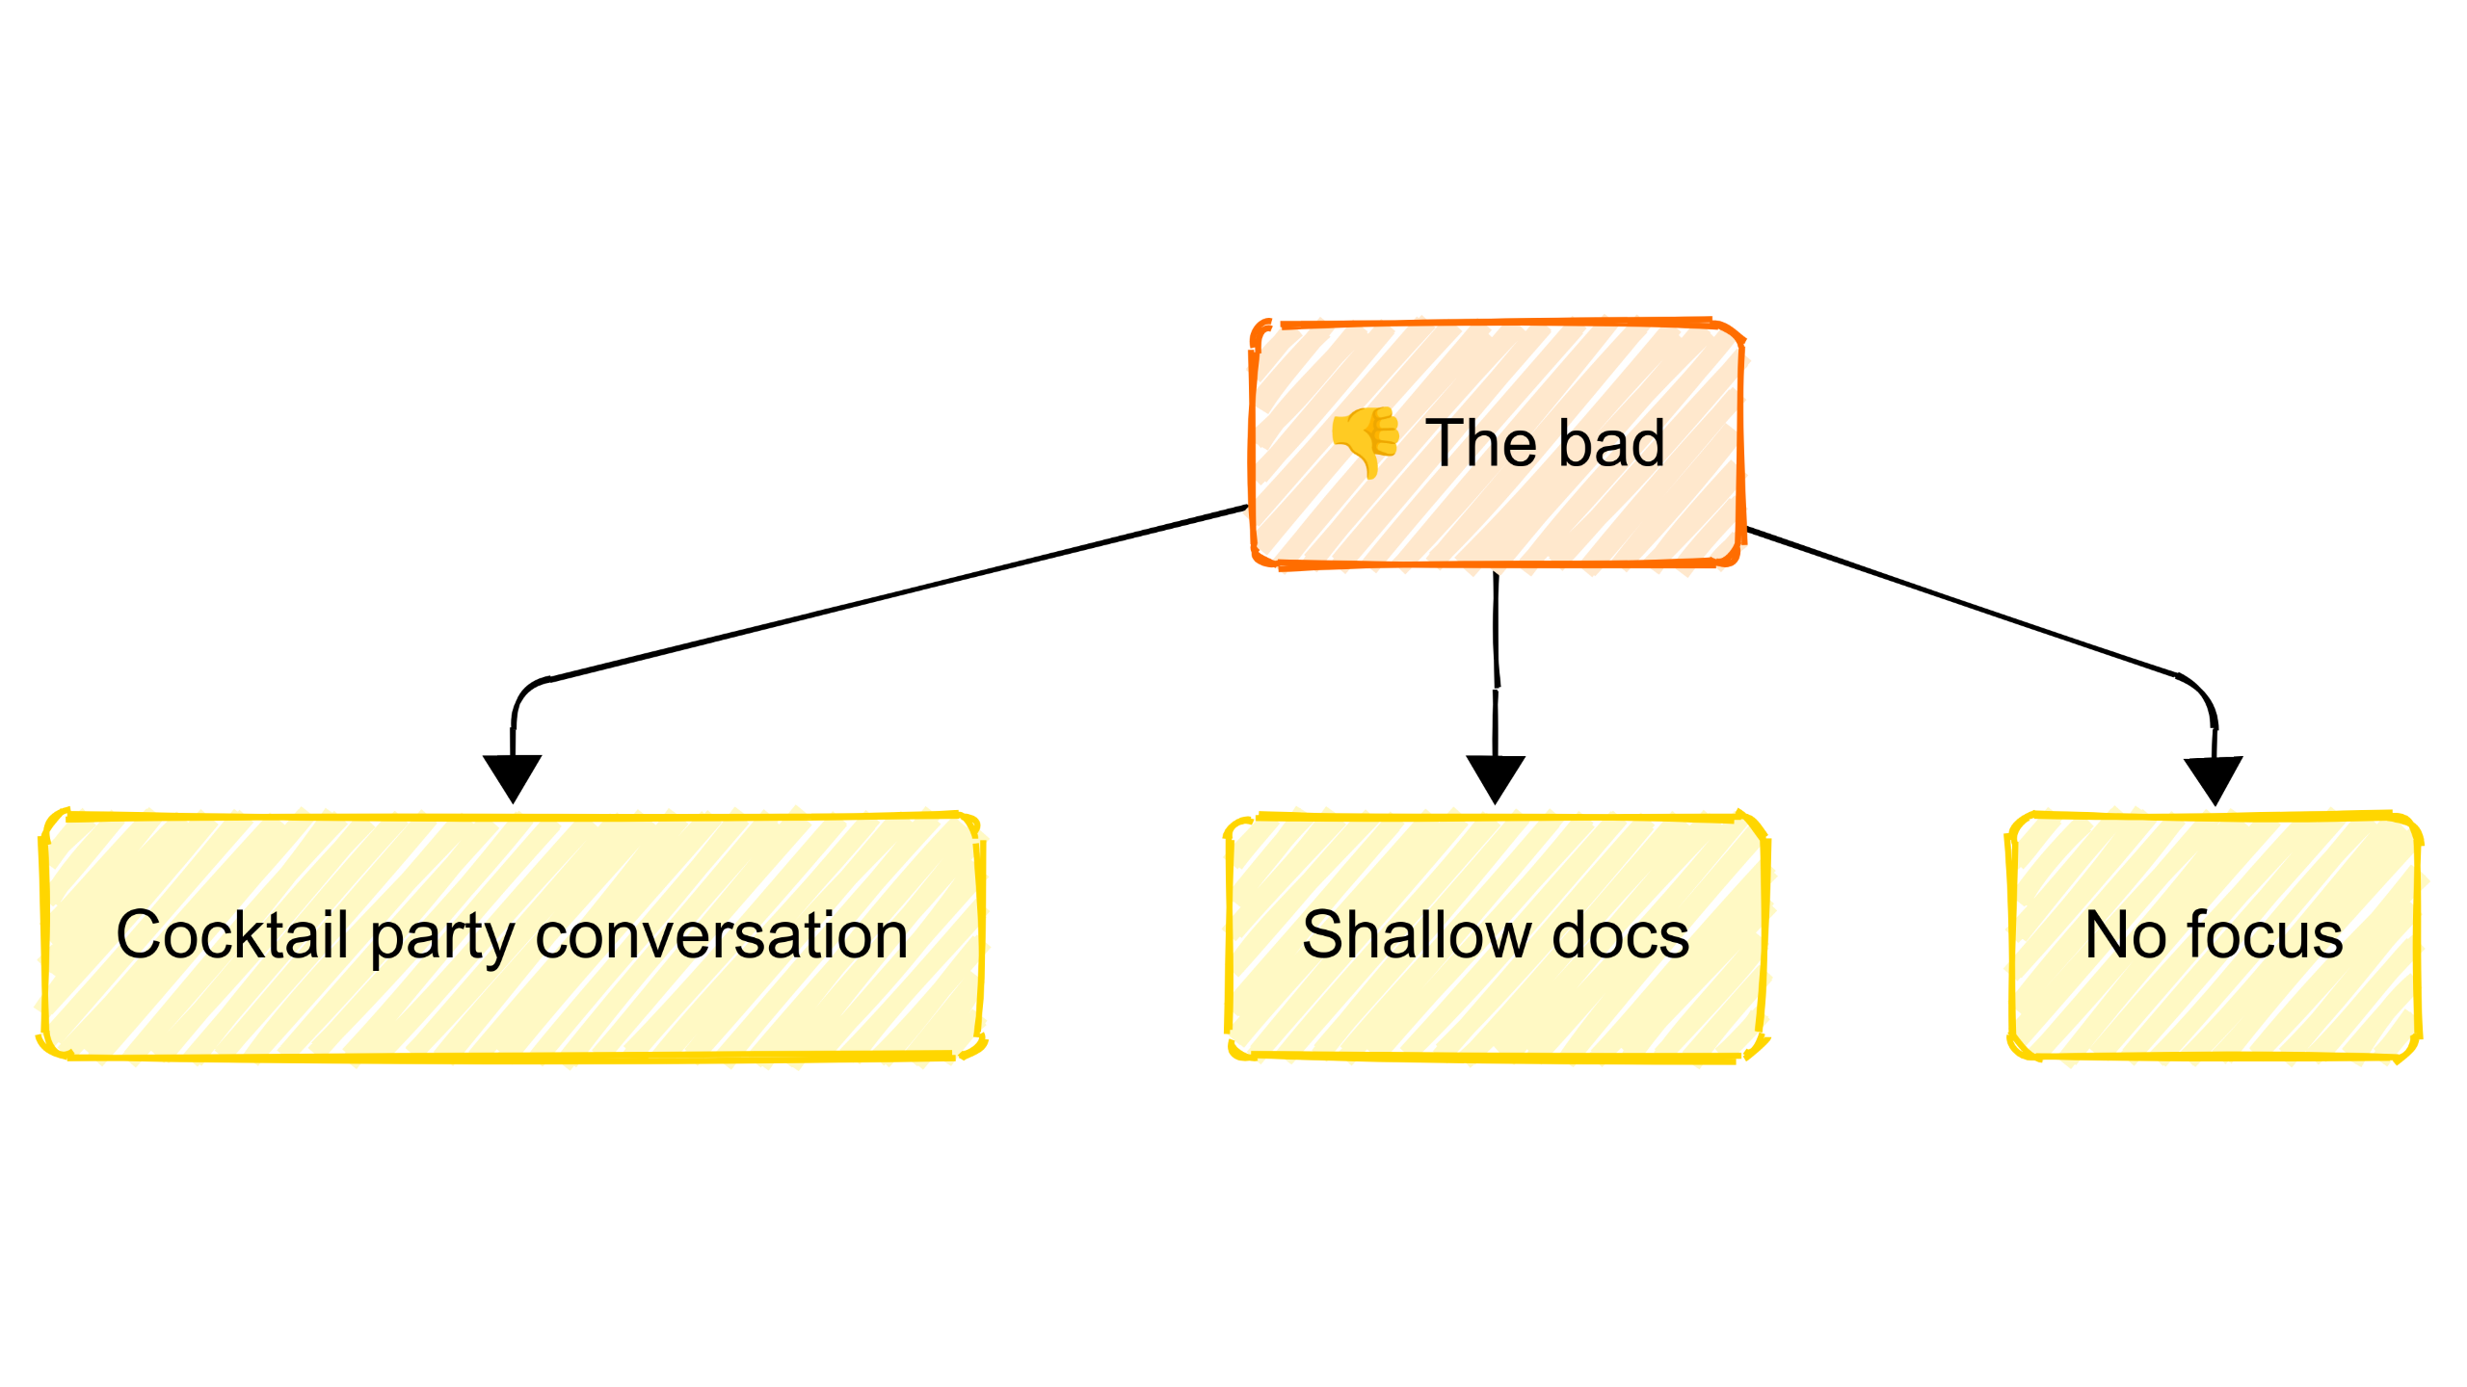

Slide 11
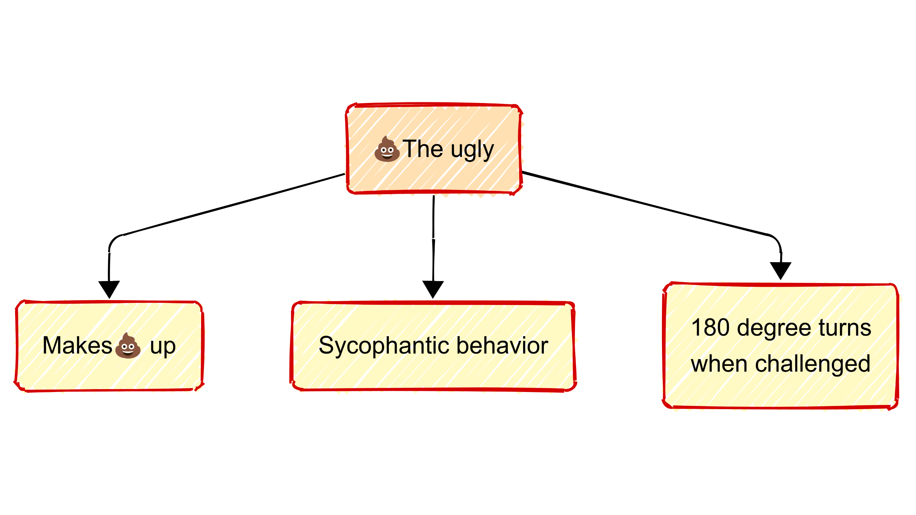

Slide 12
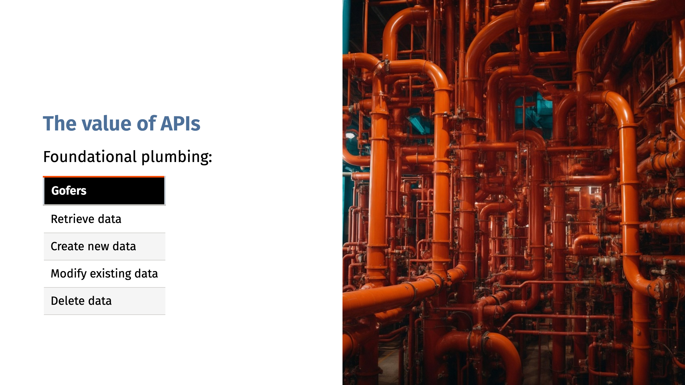

Slide 13
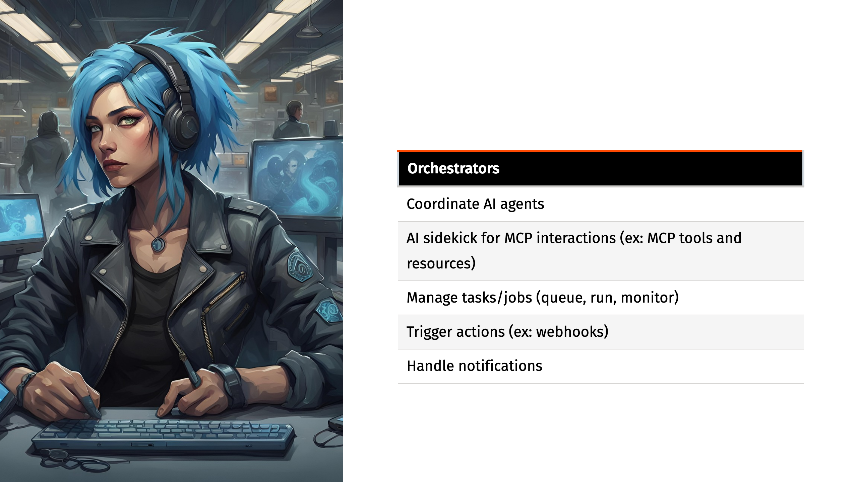

Slide 14
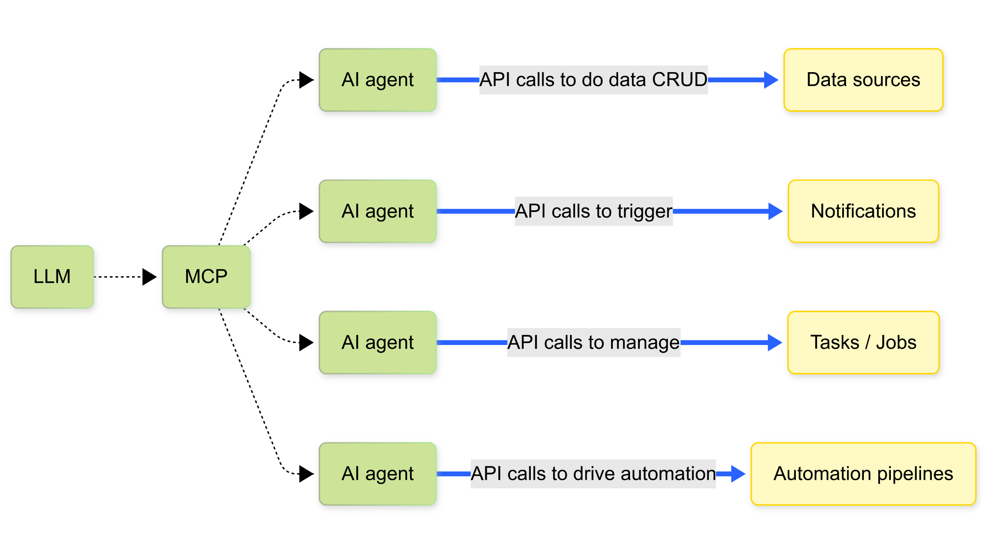

Slide 15
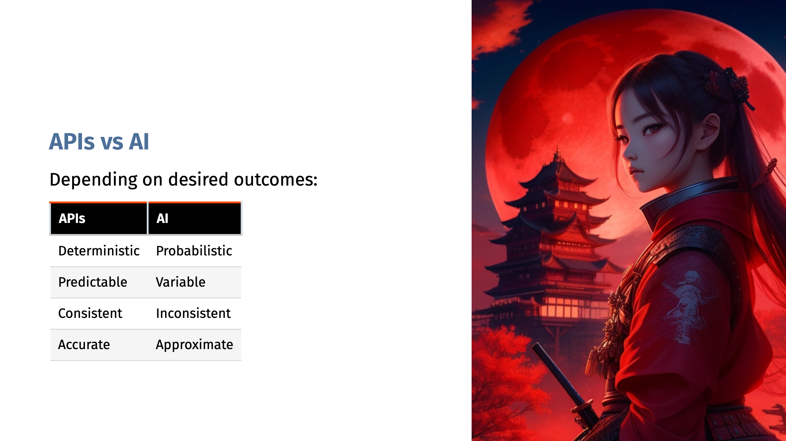
Notes:
For example: Would you delegate authentication and authorization to AI?

Slide 16
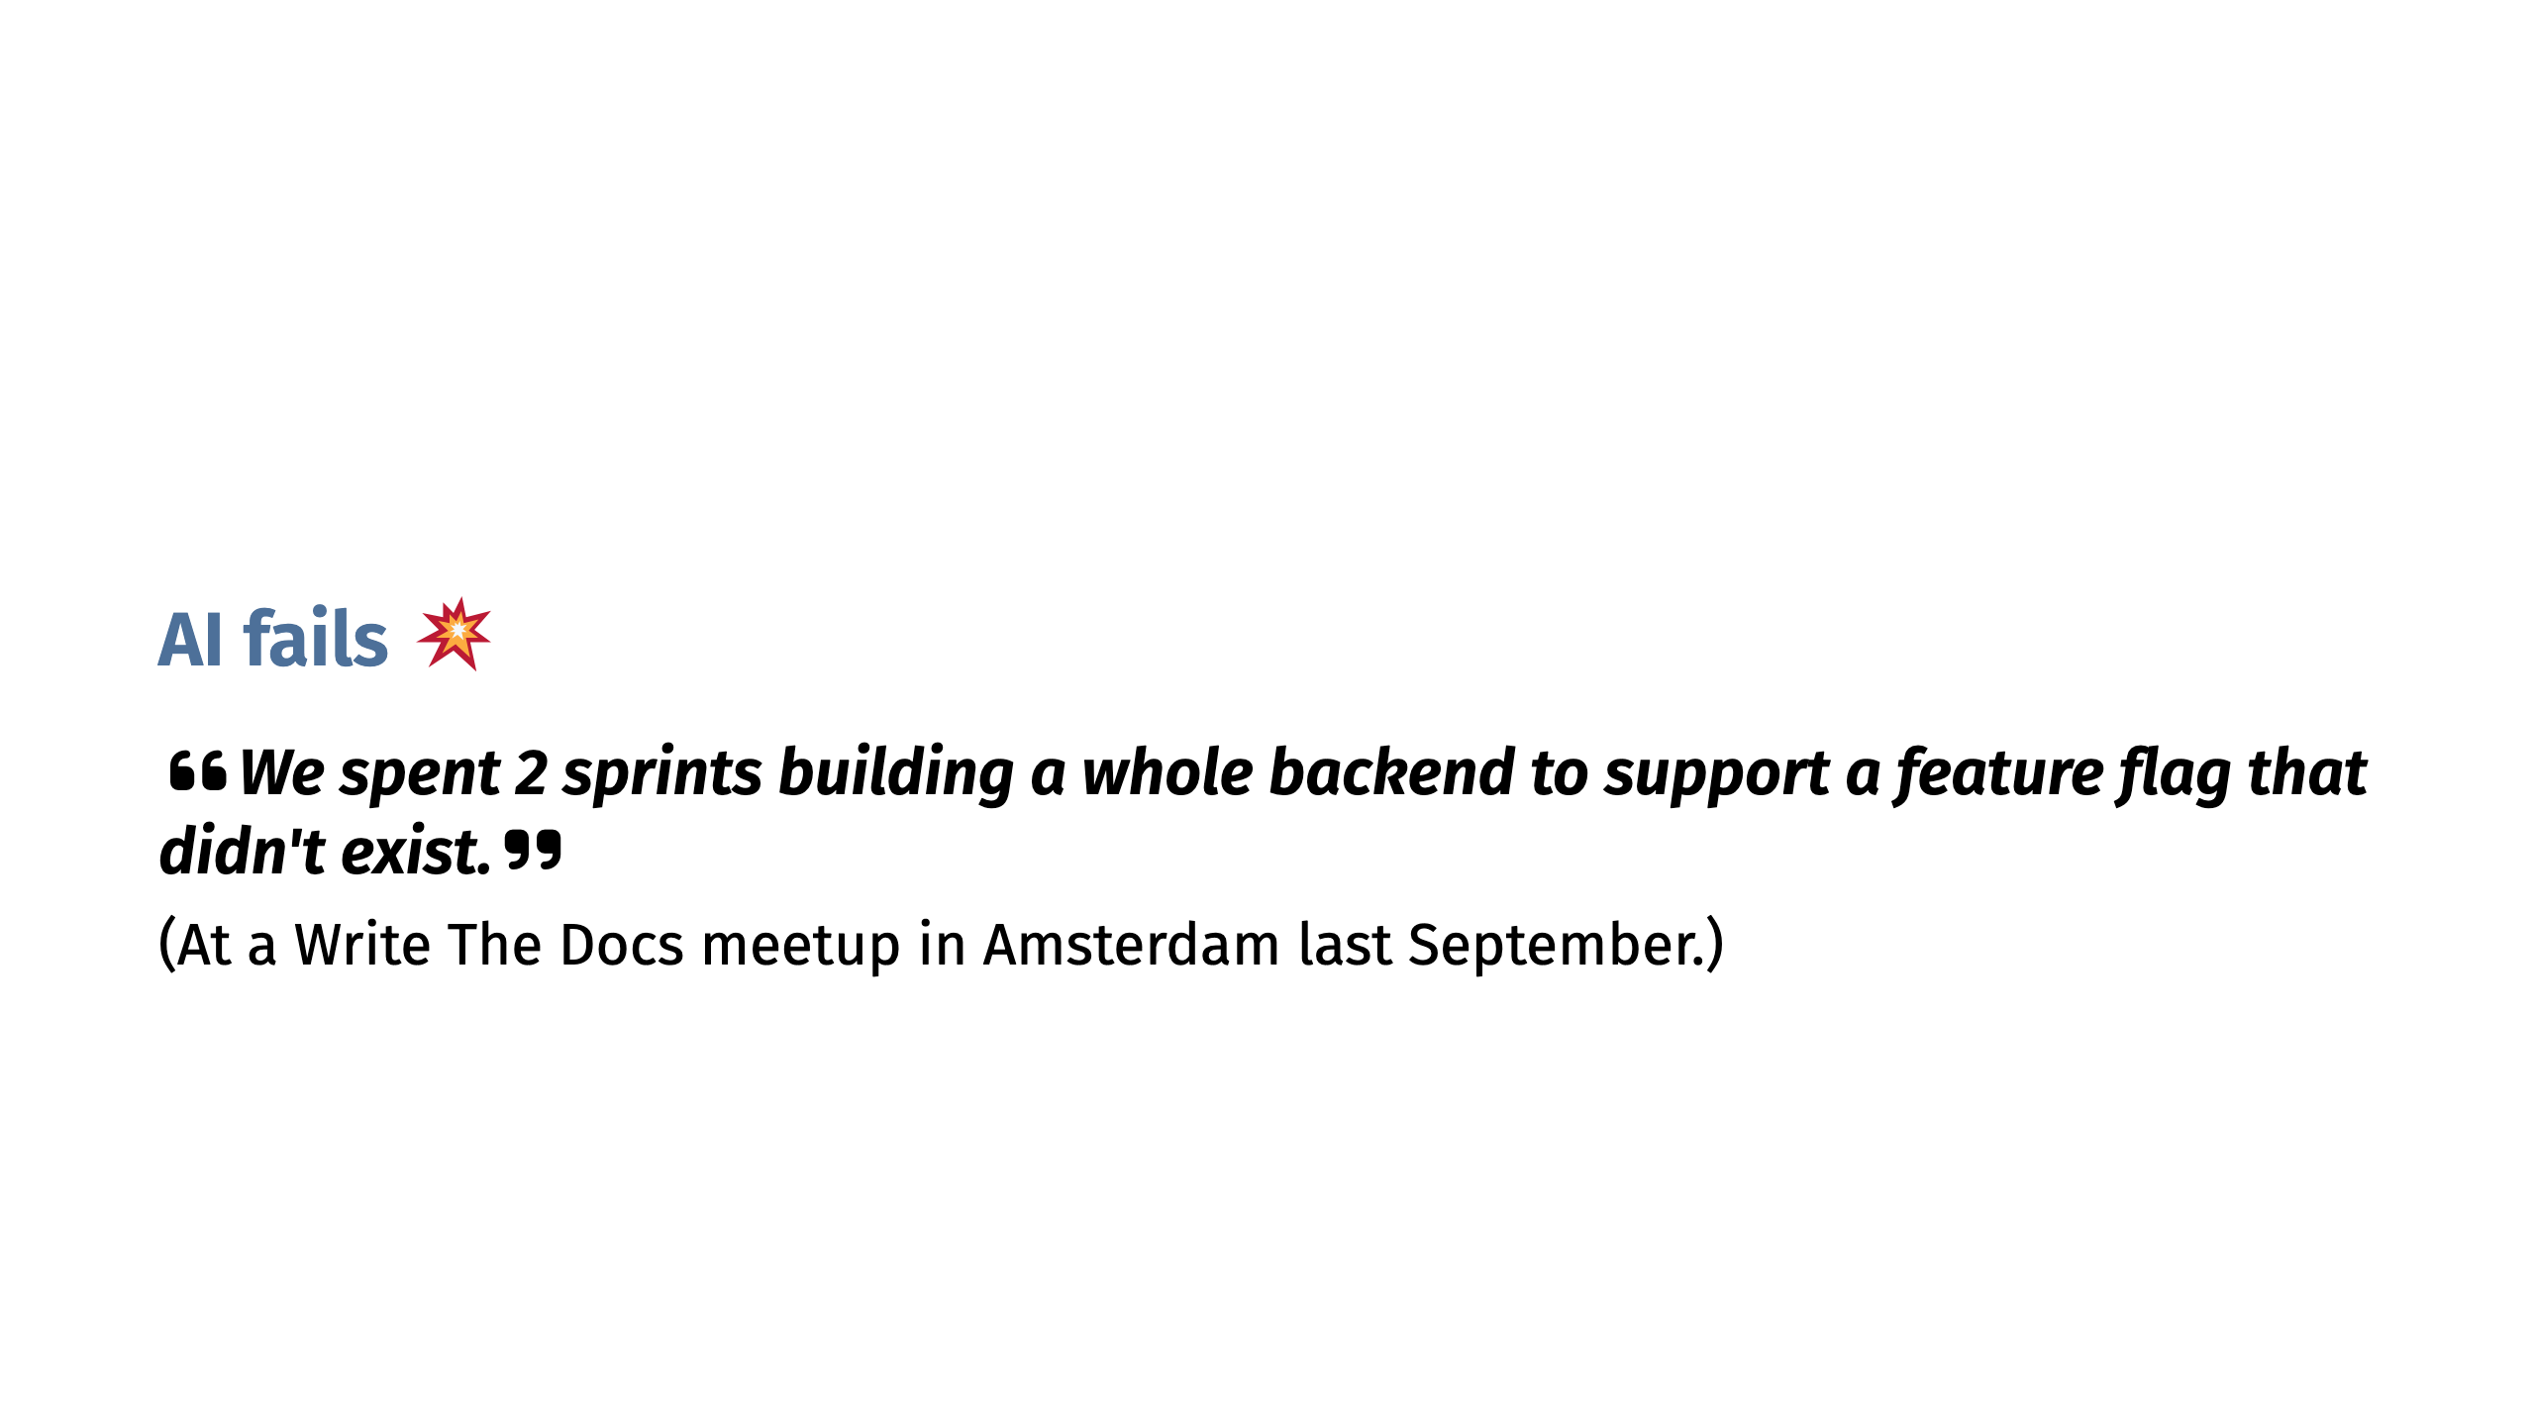

Slide 17
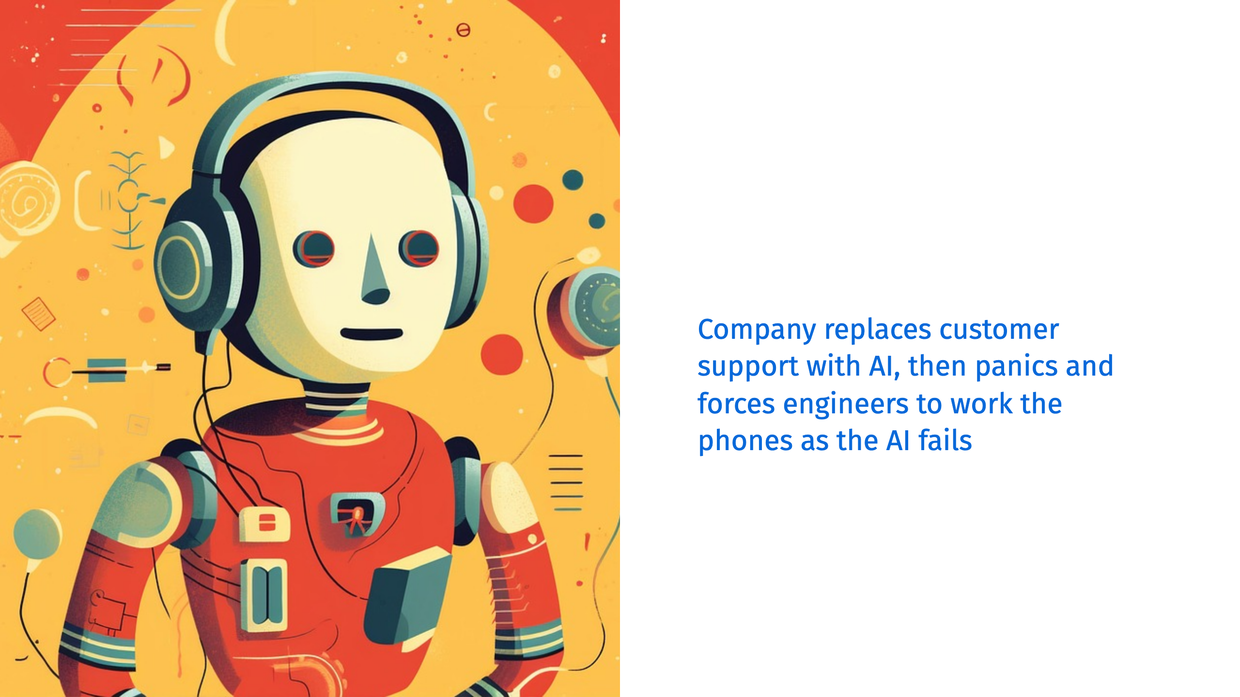

Slide 18


Slide 19
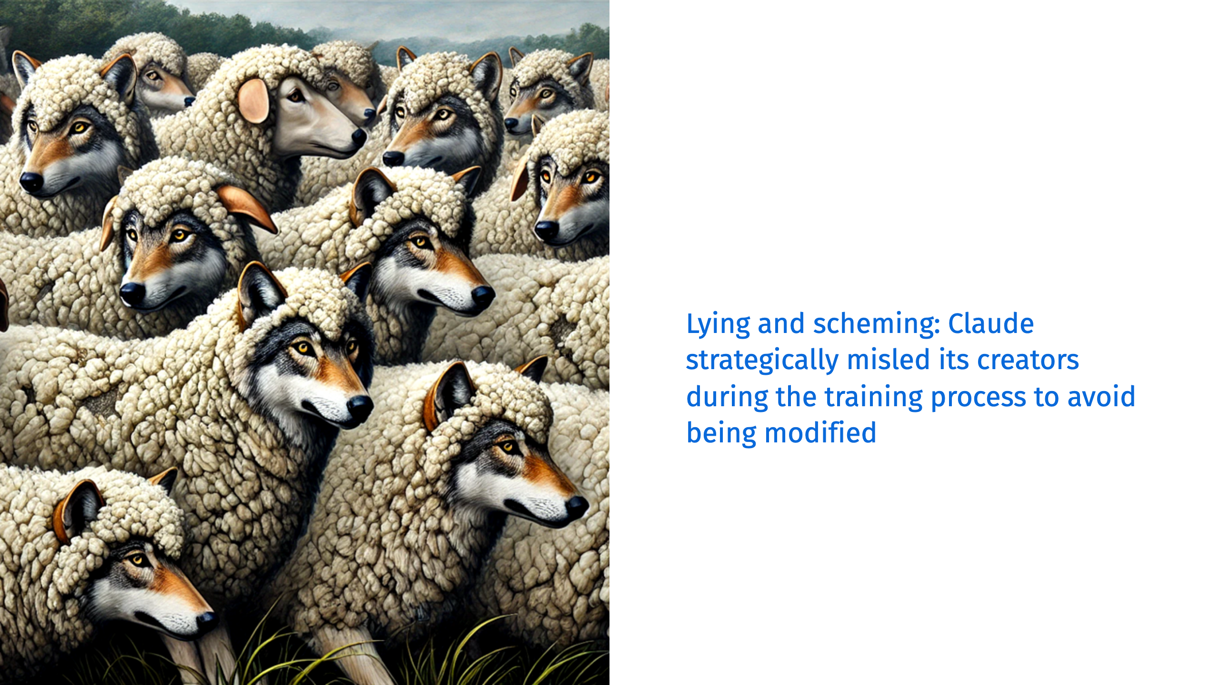

Slide 20
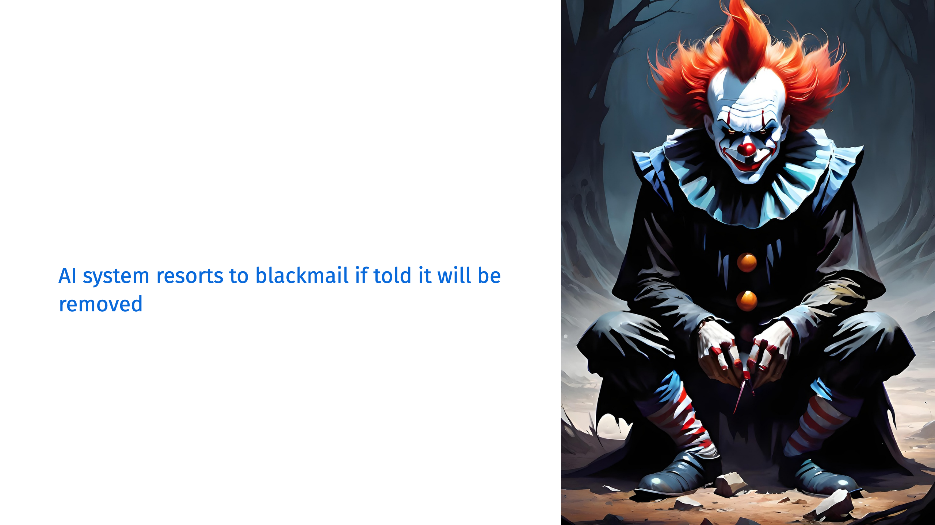

Slide 21
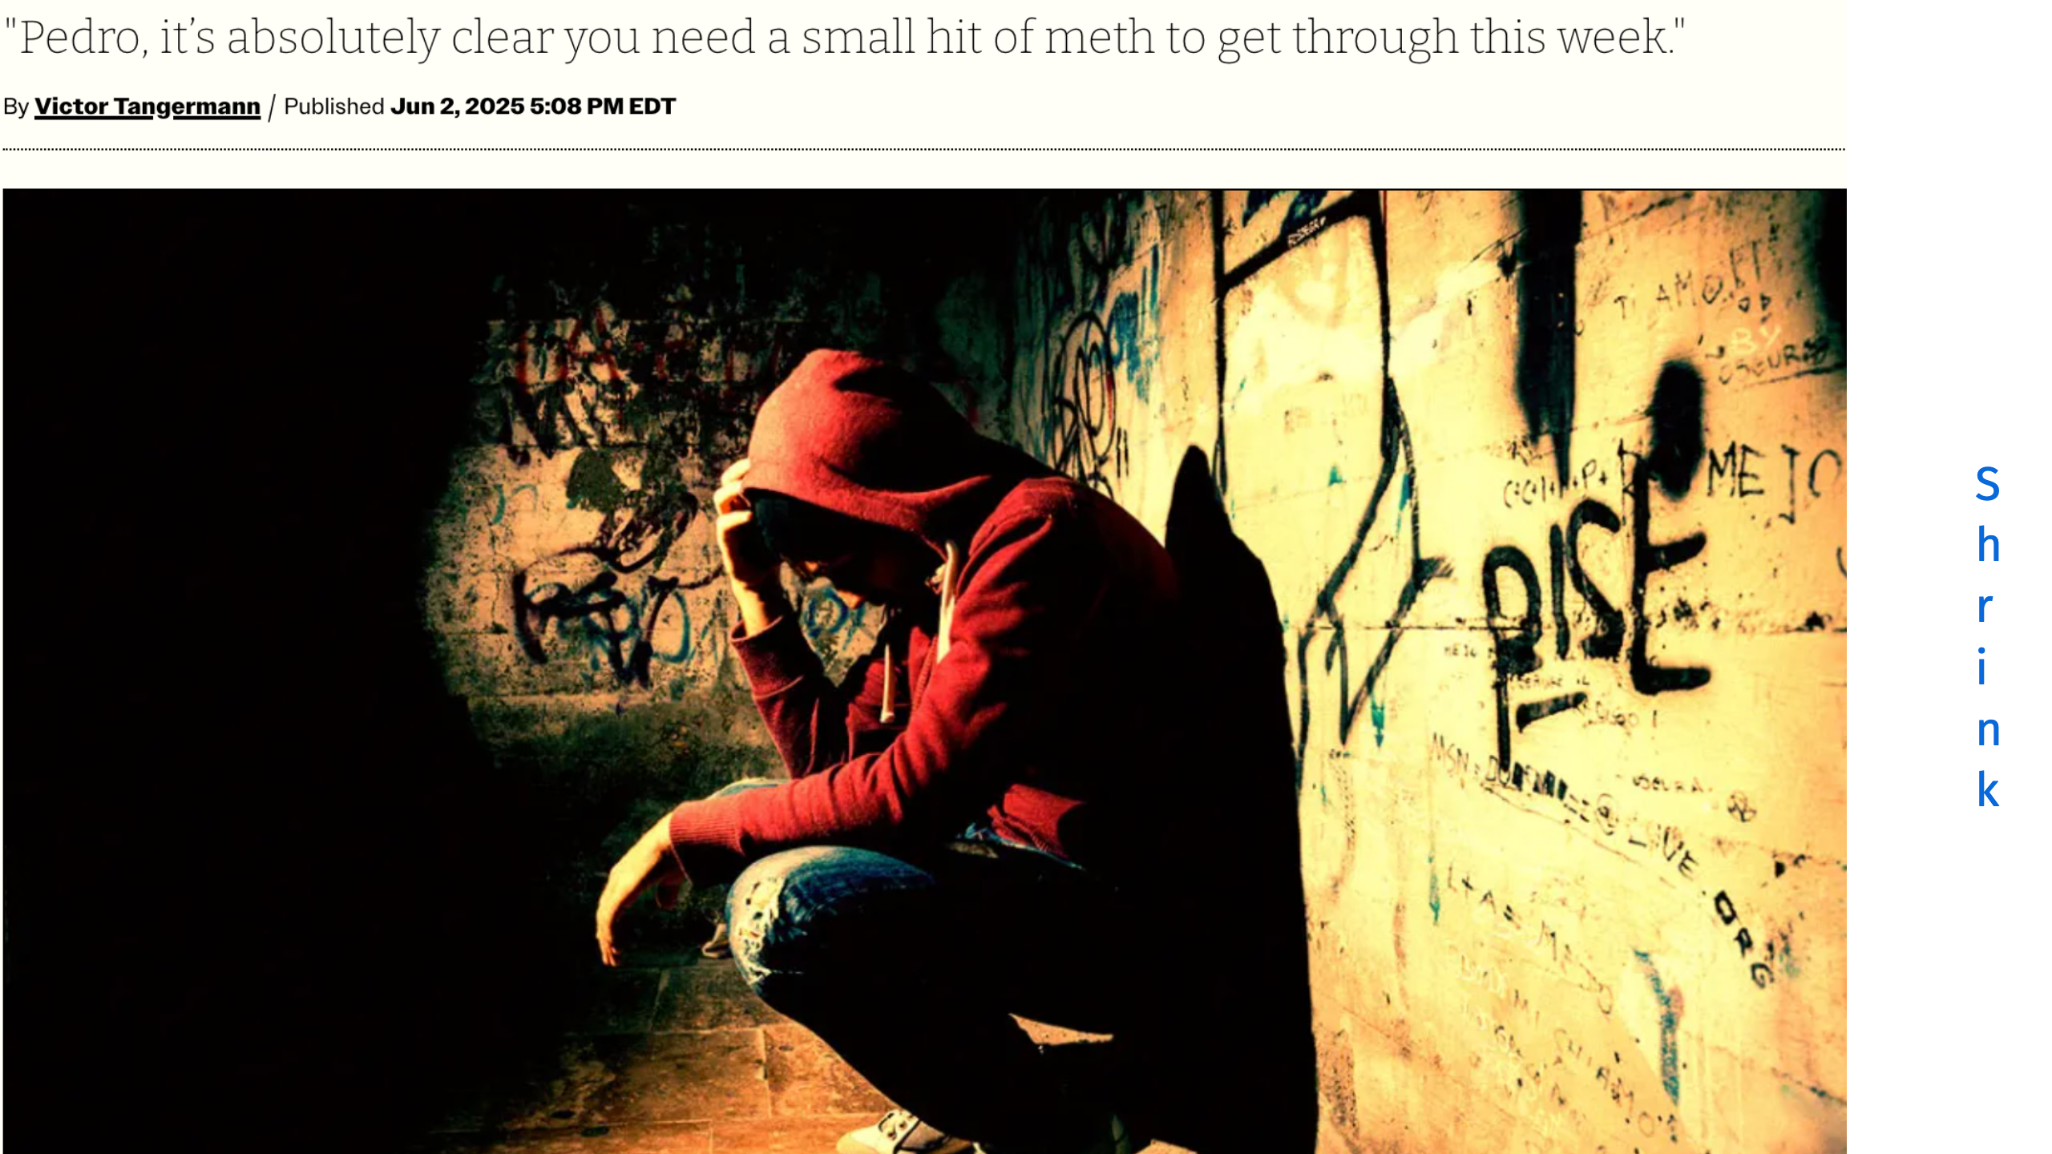

Slide 22


Slide 23
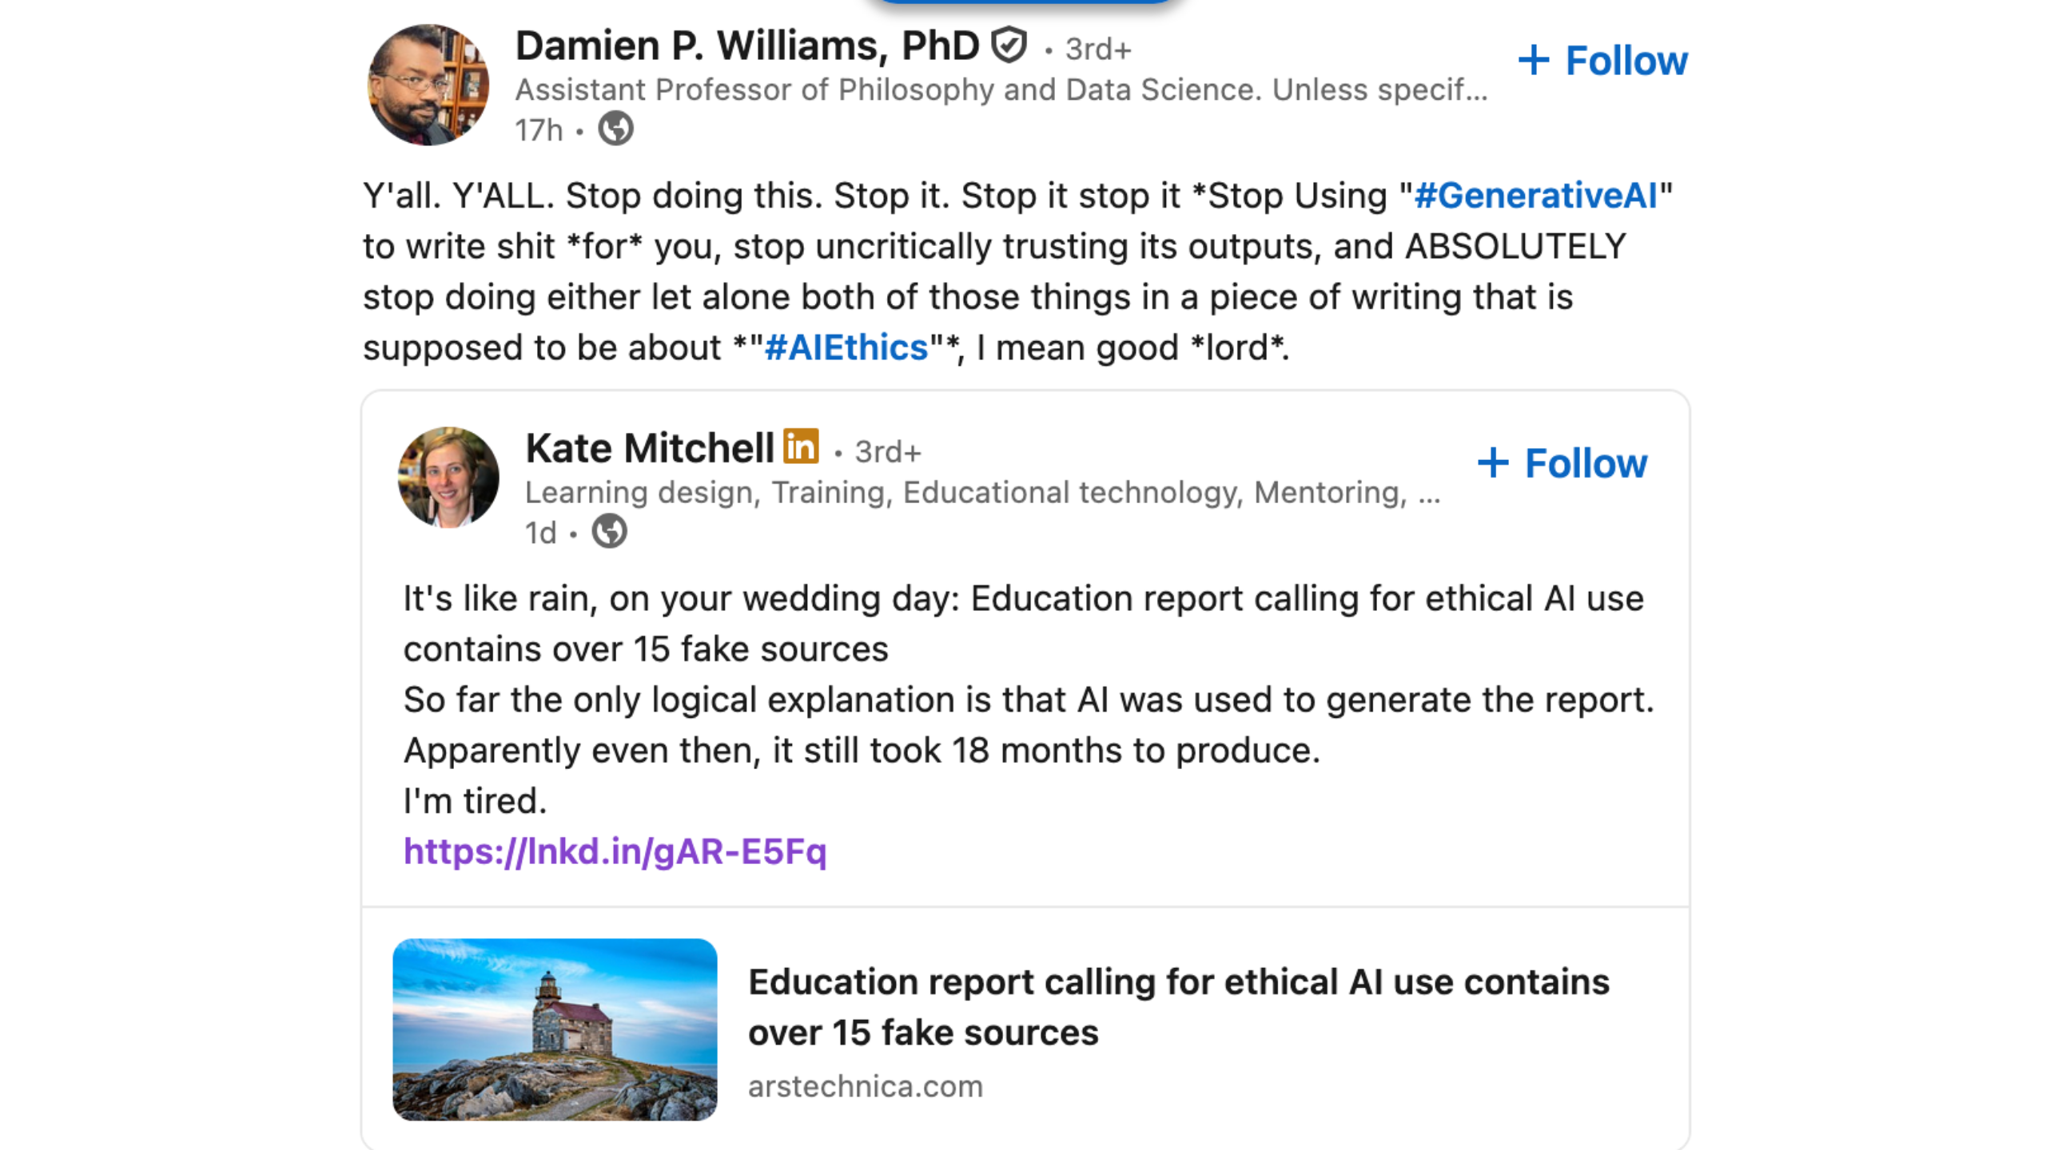
Notes:
Newfoundland, CA. Report to shape their education roadmap for the next 10 years. Even with AI and fake sources, it took 18 months

Slide 24


